Slide 1
Blacktown Chinese Christian Church
Welcome to Our English Service 22.03.2026
English Service 9:45 – 11:00 am
Worship Songs: Passage: Speaker: Topic: Response Song: Announcements and Closing Prayer Benediction
Cornerstone King of Kings Goodness of God Lord I Need You Gal 3:6-9 Xavier Lakshmanan Sons by Faith or Works?

Slide 2
BCCC english service

Slide 3
Cornerstone
CCLI Licence No: 5485849

Slide 4
My hope is built on nothing less
Than Jesus blood and righteousness
I dare not trust the sweetest frame
But wholly trust in Jesus name (x2)

Slide 5
Christ alone, Cornerstone
Weak made strong in the Saviour's love
Through the storm, He is Lord
Lord of all

Slide 6
When darkness seems to hide His face
I rest on His unchanging grace

Slide 7
In every high and stormy gale
My anchor holds within the veil
My anchor holds within the veil

Slide 8
Christ alone, Cornerstone
Weak made strong in the Saviour's love
Through the storm, He is Lord
Lord of all

Slide 9
He is Lord, Lord of all

Slide 10
Christ alone, Cornerstone
Weak made strong in the Saviour's love
Through the storm, He is Lord
Lord of all

Slide 11
When He shall come with trumpet sound
Oh may I then in Him be found
Dressed in His righteousness alone
Faultless stand before the throne

Slide 12
Christ alone, Cornerstone
Weak made strong in the Saviour's love

Slide 13
Through the storm, He is Lord
Lord of all
He is Lord, Lord of all

Slide 14
Christ alone, Cornerstone
Weak made strong in the Saviour's love

Slide 15
Through the storm, He is Lord
Lord of all
He is Lord, Lord of all

Slide 16
King Of Kings
CCLI Licence No: 5485849

Slide 17
In the darkness we were waiting
Without hope, without light
Till from heaven You came running
There was mercy in Your eyes

Slide 18
To fulfill the law and prophets
To a virgin came the word
From a throne of endless glory
To a cradle in the dirt

Slide 19
Praise the Father, praise the Son
Praise the Spirit, three in one
God of glory, Majesty
Praise forever to the King of Kings

Slide 20
To reveal the kingdom coming
And to reconcile the lost
To redeem the whole creation
You did not despise the cross

Slide 21
For even in your suffering
You saw to the other side
Knowing this was our salvation
Jesus for our sake you died

Slide 22
Praise the Father, praise the Son
Praise the Spirit, three in one
God of glory, Majesty
Praise forever to the King of Kings

Slide 23
And the morning that You rose
All of heaven held its breath
Till that stone was moved for good
For the Lamb had conquered death

Slide 24
And the dead rose from their tombs
And the angels stood in awe
For the souls of all who'd come
To the Father are restored

Slide 25
And the Church of Christ was born
Then the Spirit lit the flame
Now this gospel truth of old
Shall not kneel, shall not faint

Slide 26
By His blood and in His name
In His freedom I am free
For the love of Jesus Christ
Who has resurrected me

Slide 27
Praise the Father, praise the Son
Praise the Spirit, three in one
God of glory, Majesty
Praise forever to the King of Kings

Slide 28
Praise forever to the King of Kings

Slide 29
Goodness Of God
CCLI Licence No: 5485849

Slide 30
I love You, Lord
For Your mercy never fails me
All my days, I've been held in Your hands

Slide 31
From the moment that I wake up
Until I lay my head
Oh, I will sing of the goodness of God

Slide 32
All my life You have been faithful
And all my life You have been so, so good
With every breath that I am able
Oh, I will sing of the goodness of God

Slide 33
I love Your voice
You have led me through the fire
And in darkest night You are close like no other

Slide 34
I've known You as a Father
I've known You as a Friend
And I have lived in the goodness of God

Slide 35
All my life You have been faithful
And all my life You have been so, so good
With every breath that I am able
Oh, I will sing of the goodness of God

Slide 36
Your goodness is running after, it's running after me
Your goodness is running after, it's running after me

Slide 37
With my life laid down, I'm surrendered now
I give You everything
Your goodness is running after, it's running after me

Slide 38
Your goodness is running after, it's running after me
Your goodness is running after, it's running after me

Slide 39
With my life laid down, I'm surrendered now
I give You everything
Your goodness is running after, it's running after me

Slide 40
All my life You have been faithful
And all my life You have been so, so good
With every breath that I am able
Oh, I'm gonna sing of the goodness of God

Slide 41
All my life You have been faithful
And all my life You have been so, so good
With every breath that I am able
Oh, I'm gonna sing of the goodness of God

Slide 42
Oh, I'm gonna sing of the goodness of God

Slide 43
Lord, I Need You
CCLI Licence No: 5485849

Slide 44
Lord I come, I confess
Bowing here I find my rest
Without You I fall apart
You're the one that guides my heart

Slide 45
Lord, I need You, oh I need You
Every hour I need You
My one defense, my righteousness
Oh God, how I need You

Slide 46
Where sin runs deep, Your grace is more
Where grace is found is where You are
And where You are Lord I am free
Holiness is Christ in me

Slide 47
Yes where You are Lord I am free
Holiness is Christ in me

Slide 48
Lord, I need You, oh I need You
Every hour I need You
My one defense, my righteousness
Oh God, how I need You

Slide 49
So teach my song to rise to You
When temptation comes my way
And when I cannot stand I'll fall on You
Jesus You're my hope and stay

Slide 50
And when I cannot stand I'll fall on You
Jesus You're my hope and stay

Slide 51
Lord, I need You, oh I need You
Every hour I need You
My one defense, my righteousness
Oh God, how I need You

Slide 52
Lord, I need You, oh I need You
Every hour I need You
My one defense, my righteousness
Oh God, how I need You

Slide 53
Lord, I Need You
CCLI Licence No: 5485849

Slide 54
Lord I come, I confess
Bowing here I find my rest
Without You I fall apart
You're the one that guides my heart

Slide 55
Lord, I need You, oh I need You
Every hour I need You
My one defense, my righteousness
Oh God, how I need You

Slide 56
Where sin runs deep, Your grace is more
Where grace is found is where You are
And where You are Lord I am free
Holiness is Christ in me

Slide 57
Yes where You are Lord I am free
Holiness is Christ in me

Slide 58
Lord, I need You, oh I need You
Every hour I need You
My one defense, my righteousness
Oh God, how I need You

Slide 59
So teach my song to rise to You
When temptation comes my way
And when I cannot stand I'll fall on You
Jesus You're my hope and stay

Slide 60
And when I cannot stand I'll fall on You
Jesus You're my hope and stay

Slide 61
Lord, I need You, oh I need You
Every hour I need You
My one defense, my righteousness
Oh God, how I need You

Slide 62
Lord, I need You, oh I need You
Every hour I need You
My one defense, my righteousness
Oh God, how I need You

Slide 63
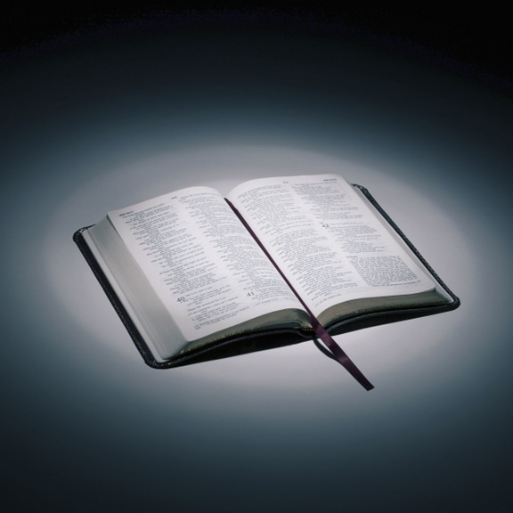
Bible reading

Slide 64
Gal 3:6-9
⁶ So also Abraham “believed God, and it was credited to him as righteousness.”
⁷ Understand, then, that those who have faith are children of Abraham.

Slide 65
Gal 3:6-9
⁸ Scripture foresaw that God would justify the Gentiles by faith, and announced the gospel in advance to Abraham: “All nations will be blessed through you.” ⁹ So those who rely on faith are blessed along with Abraham, the man of faith.

Slide 66
Announcements

Slide 67





Account name: Blacktown Chinese Christian Church
Account number: 4216 50263
Offering
BSB: 112 - 879
Please put in "offering" as the reference
The offering box is available at the back of the hall

Slide 68
Prayer points

Slide 69
Mingle time!

